Slide 1
Difference between casual and annual Cyclistic bike riders Aniq Elahi

Slide 2
Project analysis slide 2
Table of Contents
Executive Summary
Business Task
Data Cleaning, Analysis &
Findings
Data Sources
Dashboard
Recommendations

Slide 3
Project analysis slide 10
Executive Summary
The objective was to analyze last year’s consumer usage data to identify differences between casual riders and Cyclistic members (annual members); in order to aid in developing strategies that convert the former to the latter.
Relevant and credible data was sourced. Then it was cleaned using Excel & R while maintaining Data Integrity. The data was then analyzed to excerpt insights, which were then visualized (similar to the figure on the left).
The insights and visuals were used to detail key findings about how casual riders differed from members, which were then used to develop suggestions on persuading casual riders into becoming members.

Slide 4
Project analysis slide 4
Business Task
Management Objective
Project Objective
Project Outcome
To identify the differences between Cyclistic members and casual riders, through the analysis of last year’s usage data.
Developing an understanding to guide a future marketing program.
The creation of marketing strategies that aim to succeed in converting casual riders into member.

Slide 5
Project analysis slide 11
Data Sources
The last 12 months (2019-2020) of Cyclistic’s historical trip data was used in my analysis.
The data was sourced from Motivational International Inc. and is public data, under license.
This data is amongst the most credible due to it being original, comprehensive, current, and cited.
It is free from bias as it contains all of the trips in the given timeframe, instead of a sample of them.
The only uncorrectable issue with data is that repeat riders cannot be accounted for, due to data-privacy laws preventing the disclosure of identifying information like credit card numbers.
The copy of the data I used, is stored on a local drive; the raw data is organized in folders named different months of the year, containing the corresponding files.

Slide 6
Project analysis slide 7
Data Cleaning
The full process was documented and is available upon request. A summary is given below. Additionally, data integrity was maintained by keeping the process consistent and not altering important figures.
The data came in the form of a spreadsheet for each month, so the first thing I did was save them all as workbooks.
Next, I added columns ride_length and day_of_week to aid in analysis.
Thereafter, the following error containing rows were removed or corrected:
Rows with start times before their end times, and rows that have start and end times on different dates (rides that went on for longer than a day).
Any row with a duplicate id.
Rows with blank or null values that could not be corrected.
Some rows were missing a start_station_name value, which was corrected using it’s start_latitude value.
Lastly, the worksheets were merged into their corresponding quarters, creating the four files that were used in the analysis.
Microsoft Excel
Libraries like tidyverse and lubridate were used to aid this process.
Once the data was uploaded onto R, the columns were inspected, first for their names, then their data types.
Following the inspection, many changes were made: multiple columns were renamed either for cohesion or ease of use (for example 01 - Rental Details Rental ID became ride_id) and some data types were changed too (like the ride_ids of the different files were different types, so they were all converted to strings).
Subsequently, the four data frames were merged into one, and conflicts like overlapping data and unique columns were removed (the 2020 datasets had columns that weren’t in the 2019 ones so they were removed).
Lastly the data was made cohesive by correcting any deviations from the expected values, and columns like day and month were added to aid in analysis.
R

Slide 7
Project analysis slide 6
Analysis Insights
The average ride length for all customers is 19.13 minutes, however the casual rider averages a ride length of 39.56 minutes, while members average 12.94 minutes. Members and casual riders both rode longer on weekends, with the highest average ride lengths coming on Saturday, followed by Sunday.
Of the total 3,874,095 trips taken that year, members took 2,973,420 rides, while casual riders took 900,675 rides, 76.75% and 23.25% respectively. Members took more rides during the weekdays, with the highest day being Tuesday followed by Wednesday, casual riders took more on the weekends, with their highest day being Saturday followed by Sunday.
The seasonal data shows, that casual riders rode the longest in Spring (41.28 minutes) but took a lot more rides in the Summer (492,124 rides). While members also took the largest share of their rides in the Summer (1,129,991 rides), their longest average ride duration occurred in the Summer (14.09 minutes) too. Naturally, Winter saw the shortest amount of rides, however, both types of riders took more significantly more rides in the Fall than in the Spring, even though they rode for longer during the latter.
As for the monthly data, casual riders rode for longer in May (41.58 minutes) followed by March (41.07 minutes), but they took more rides during August (186,625 rides), and July (175,433 rides). Members also saw the most rides taken during August (403,241 rides) and July (381,615 rides), with their longest rides taking place in July (14.35 minutes) ahead of June (14.04 minutes).
When looking at hours, casual riders travelled the longest from 10:00-11:00 (46.43 minutes) this trend continued until 14:00; however, the largest number of rides take place between 17:00-18:00 (86,642 rides), although this is the peak ridership is usually high from 13:00. Members travelled the longest from 17:00-18:00 (13.77 minutes) the next longest starts at 12:00; furthermore, the largest number of rides also take place between 17:00-18:00 (86,642 rides), with the next two time slots starting at: 16:00 and 8:00.
Both casual riders (50%) and members (63%) preferred classic bikes, but casual riders were more likely to use other types of bikes, the second most popular amongst them being the electric bike (which 36% of casual riders take). Casual riders account for: 77.4% of the 1,947 bikes not returned within 24 hours, this year.

Slide 8
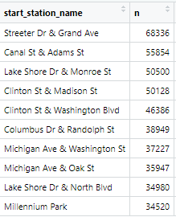
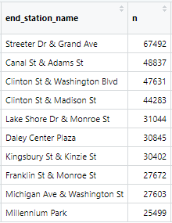
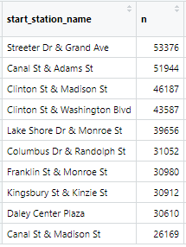
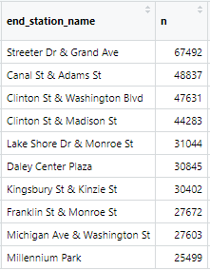
Popular Stations
Casual Riders
Members

Slide 9

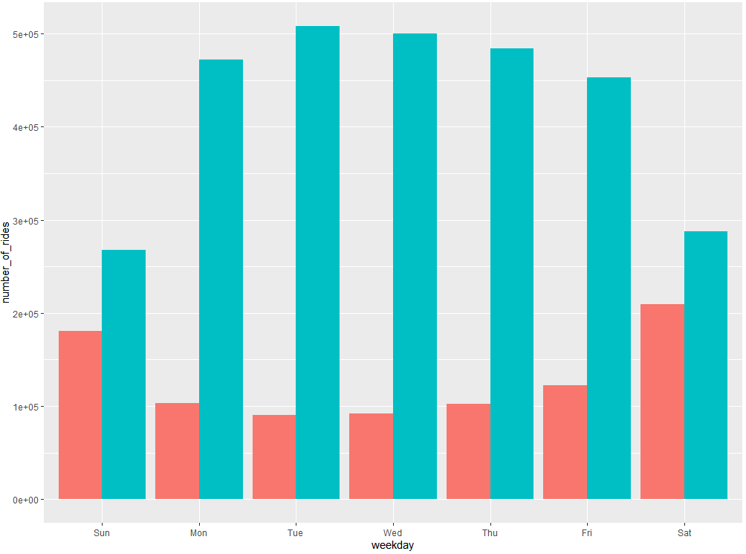
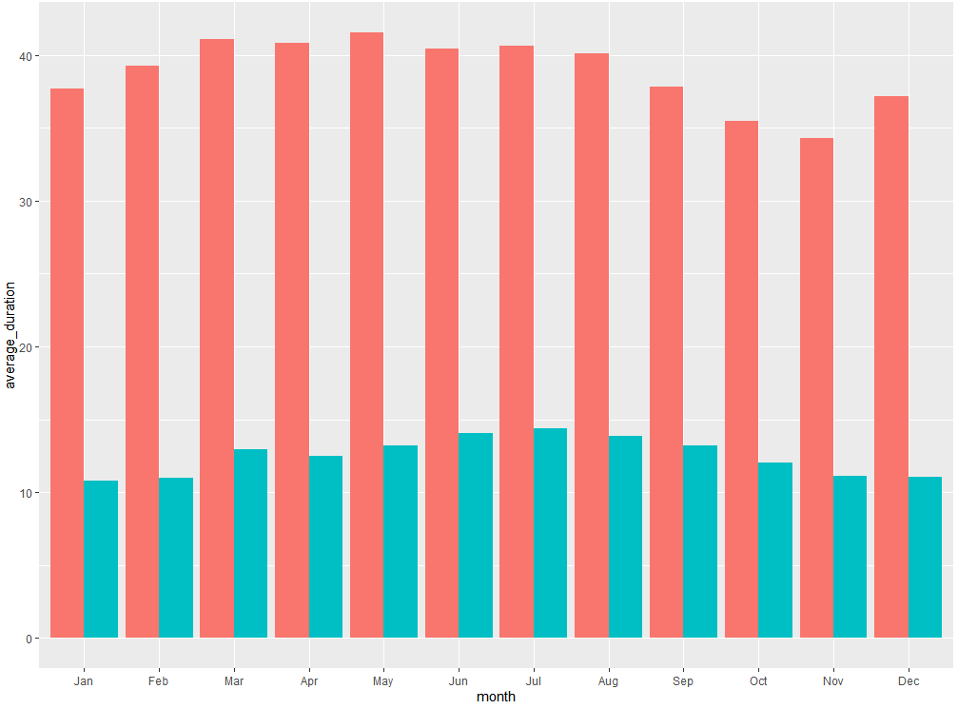
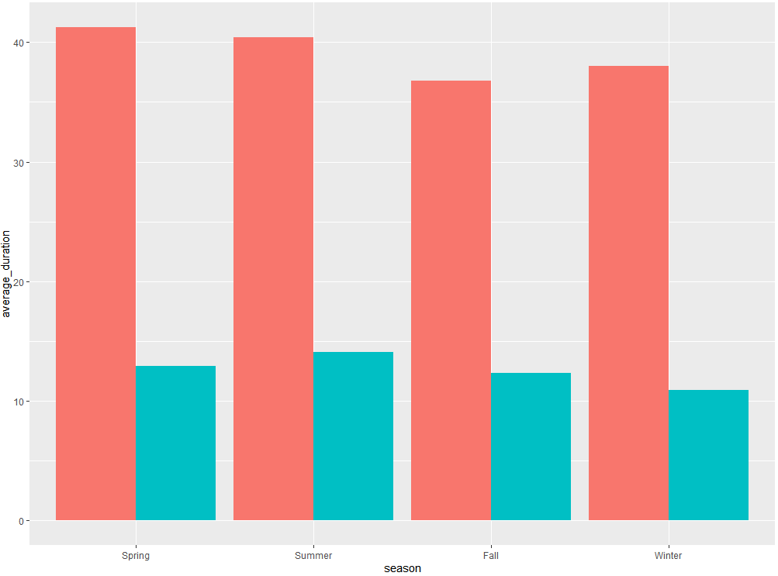
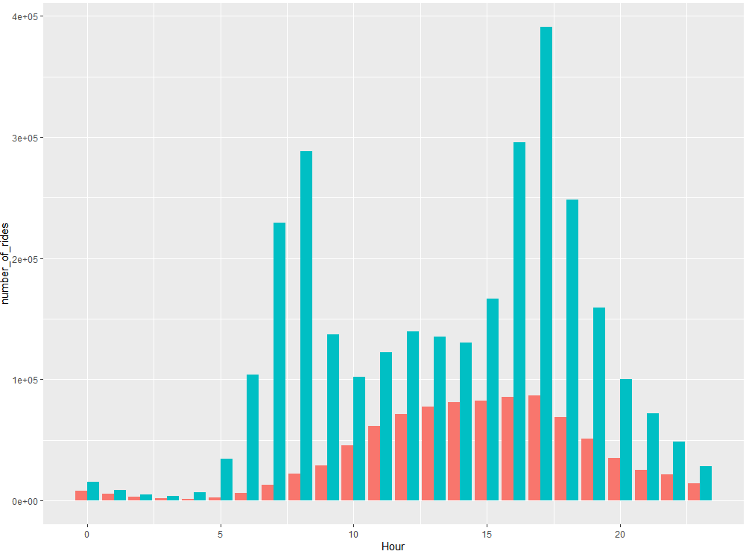
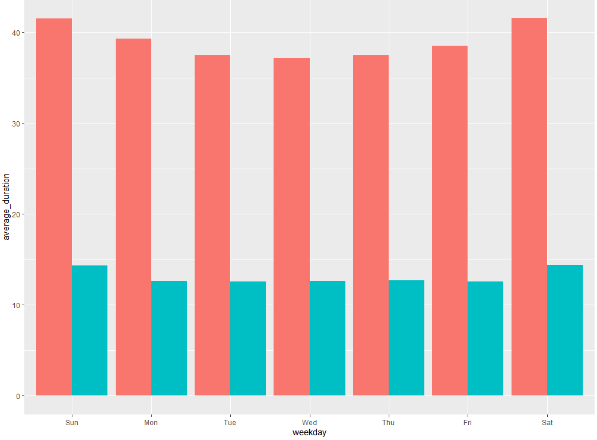
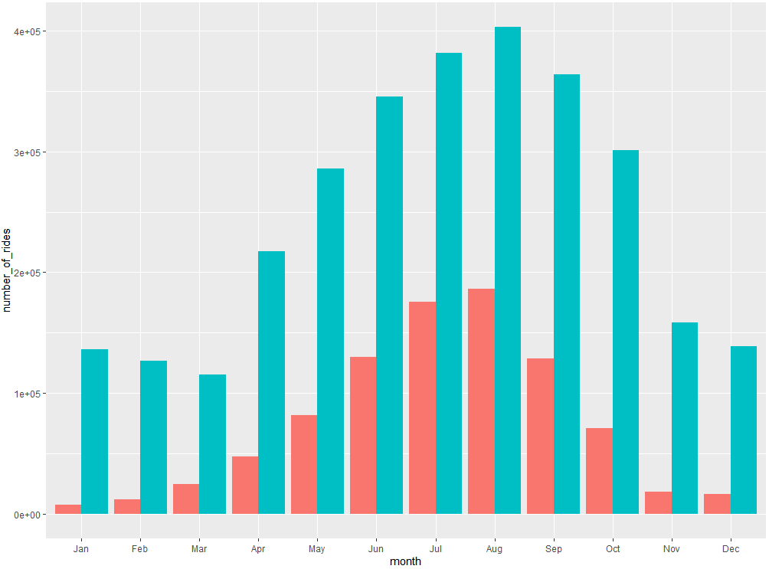
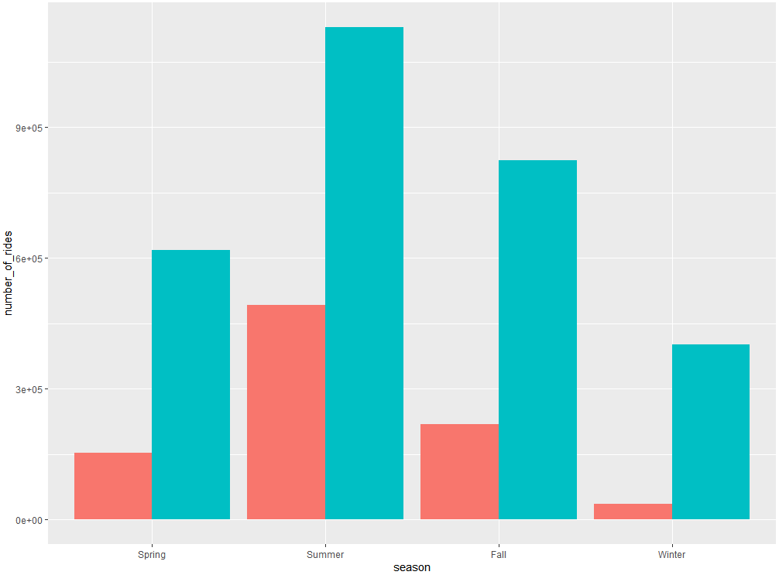
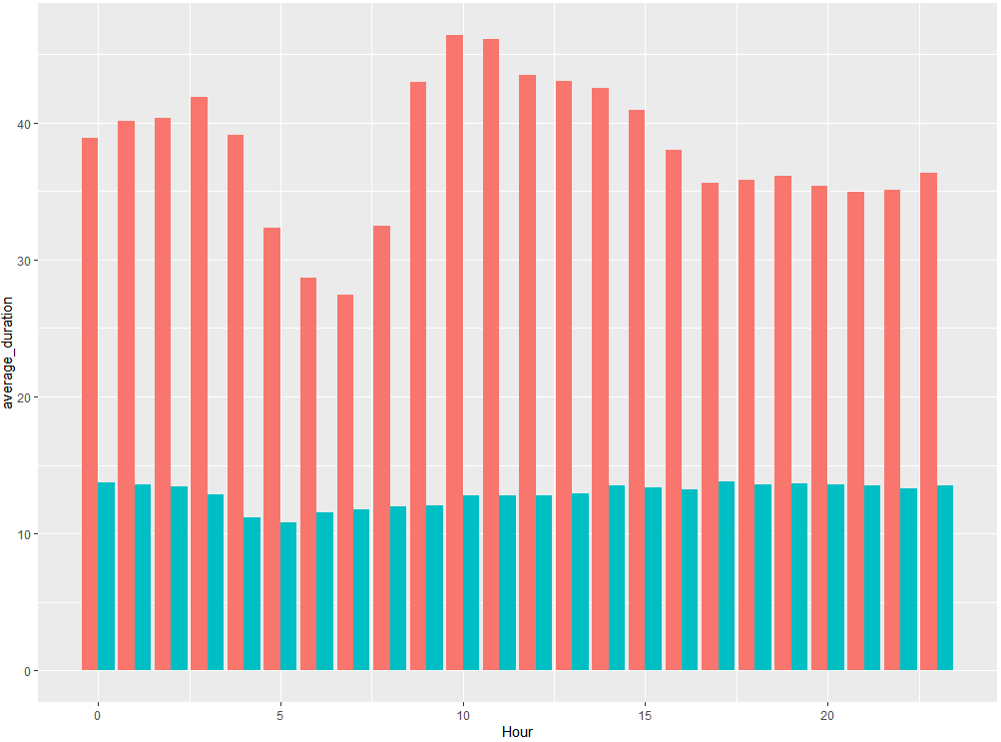
Project analysis slide 5
Dashboard
Number of Rides per Day
Monthly Average Ride Duration
Seasonal Average Duration
Number of Rides per Day
Daily Average Ride Duration
Number of Rides per Month
Number of Rides per Season
Hourly Average Duration

Slide 10
Project analysis slide 8
Key Findings
Members rode much more on weekdays than on weekends, the complete opposite of the casual riders that rode more on weekends than the weekdays. This implies that most members use the cycles to bike to work, while most casual rider use them for leisure on the weekends. This finding is further backed up when combined with the hourly data, with hours typically associated with commuting, 8 and 17, seeing the largest amount of members riding at a time, while afternoons to evenings have the largest casual rider (a common time to engage in leisurely activities). Furthermore, casual riders almost always rode for much longer than members, which would only be the case if they riding for the sake of relaxation, fitness, or enjoyment. These three factors combined paint a very clear picture of what each type of rider is using the service for.
Seeing as the average duration of rides roughly stayed the same (only being slightly higher in pleasant months), it implies that both casual users and members use the bikes for the same purposes all year around. For example, casual riders are likely continuing their exercise or well being regiments, while members are likely commuting as always.
While there aren’t too many rides that take place late at night (after midnight but before dawn), they seem to be some of the lengthiest trips implying they’re being taken out of necessity, even by casual riders.
When looking deeper into some of the most popular starting and ending stations, you can tell that member’s usage tends to be more scattered throughout the city, split almost evenly between residential and commercial areas. While casual members are similar, a sizable potion have higher usage closer to parks, on the waterfront, or in areas with entertainment, further driving home that their usage is more geared towards leisure and fitness. Some of the popular locations for casual riders are tourist attractions as many tourists also use the service, however, these places likely don’t see much local footfall, therefore keeping members away.
Of the many types of bikes offered by Cyclistic, the standard bike is by far the favorite for both types of customers, however, when looking at the percentage of rides that took place on each type of bike, casual riders were more likely to choose a bike other than a classic one. This means more casual riders might be interested in using electric bikes, or cycles that are easier to use over longer distances, but they deterred from becoming members due to the low availability of these bikes.
Casual riders are more likely to misuse or not return bikes, like the statistics show, 77% of bikes not returned within a day were rented by casual riders. Likely due to the lesser consequences they would face when compared to a member.

Slide 11
Project analysis slide 3
Recommendations
MARKETING STRATEGY
TECHNICAL STRATEGY
FINANCIAL STRATEGY
LOCATION STRATEGY
ENVIRONMENTAL STRATEGY
Casual riders are using the bikes for leisure rather than commuting. Advertising can lean into this aspect by having the membership ad campaigns centered around things like affordable fitness, and exploration. These ads can also include a casual rider’s savings with a membership on a single long trip compared to paying by the minute.
Most riders will become aware that it is more cost effective for them to become members as on average they have high ride durations. However, as they have significantly less ride counts per month, this arrangement is more beneficial to Cyclistic.
Adding safety features like alarms, emergency buttons, or small cameras will dissuade misuse, while incentivizing more people to choose our service for late night trips, and encourage casual riders already using this service, to avail a membership, due to perceived security features.
Advertising should focus on themes like: night shifts, night outs, and security. Additionally, it can create brand loyalty amongst members who bike at night.
Offers like seasonal passes or free trials, should be made, so that casual riders can experience temporary membership in order to incentivize them to become a full-fledged member.
The best time to make this offer would be in March as usage increases in the Spring and Summer.
The location of the ads should primarily be in the most popular start and end stations of casual riders with the exception of tourist areas during tourists seasons, for instance, on Grand Avenue in the Summer.
More electric and assistive bikes in stations like “Streeter Dr & Grand Ave” and “Canal St & Adams St”, which are popular with casual riders. This will make the bikes more accessible to the casual riders which should increase their desire to become members.
Although only a small proportion of riders used Cyclistic bikes during the winter, the underlying themes from the data suggest a great opportunity. The data implies, that both groups active during the winter were performing the same activities they had throughout the rest of the year (e.g. commuting or a fitness plan), hence equipping the bikes to deal with the cooler temperatures would enable more to do the same, and should give confidence in an annual membership to casual riders.
Some of the implementations could be things like: lower tire temperature, warmed bikes, plastic handles and etc.

Slide 12
Thank You

